Slide 1
The Three Musketeers (Team 10)
Deep Image Prior
Paper Link: https://arxiv.org/pdf/1711.10925.pdf
Aman Khandelwal (2022201010)
Nikhil Khemchandani (2022201042)
Piyush Singh (2022201032)

Slide 2
Problem Statement
ConvNets are commonly trained on massive image datasets.It's possible to believe that their exceptional performance results from their ability to learn realistic data priors from examples.
However, this explanation is not sufficient because not all image priors need to be acquired through data learning.A significant portion of image statistics can be captured by the structure of generator ConvNets, without any learning.This is particularly relevant for addressing specific image restoration tasks.
In these tasks, the image prior must compensate for the loss of information incurred during degradation.For such tasks, the statistics required can be obtained from the ConvNet structure itself, rather than from data learning.

Slide 3
Solution Proposed in the Paper
The proposed solution in the "Deep Image Prior" paper presents a new paradigm for image restoration tasks that exploits the inherent structure of deep neural networks, and provides an alternative to traditional data-driven approaches such as..
Denoising: the process of removing noise from an image.
Inpainting: the process of filling in missing or damaged portions of an image, for example, when part of an image has been obscured or removed.
Super-resolution: the process of increasing the resolution or size of an image beyond its original dimensions, often used to improve the clarity and quality of images.

Slide 4
Scope of the Project
We have implemented two applications from the paper :
Denoising
Inpainting
2.1. Text Inpainting
2.2. Randomly Damaged Pixels Inpainting(RDP)
2.3. Region Inpainting

Slide 5
Timelines
First Discussion Date
Final Submission Date
27th March, 2023
7th May, 2023
23th April, 2023
8th May, 2023
Mid Evaluation Date
Final Presentation

Slide 6

Implementation Details
Auto Encoders
HourGlass Model
Denoising
Inpainting
Region Inpainting
Text Inpainting
RDP
Inpainting

Slide 7
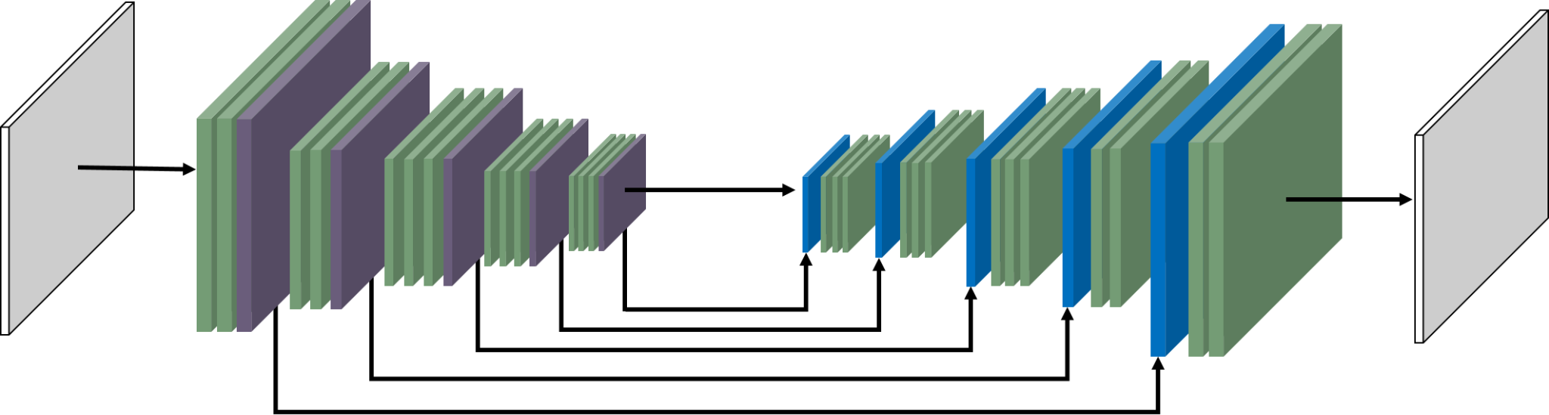
HOURGLASS MODEL -
The network consists of a contracting path and an expansive path, which gives it the u-shaped architecture.
The contracting path is a conventional convolutional network, consisting of convolutions applied repeatedly, each followed by a Leaky rectified linear unit (Leaky ReLU) .
The expansive pathway combines the feature and spatial information through a sequence of up-convolutions and concatenations with high-resolution features from the contracting path.

Slide 8
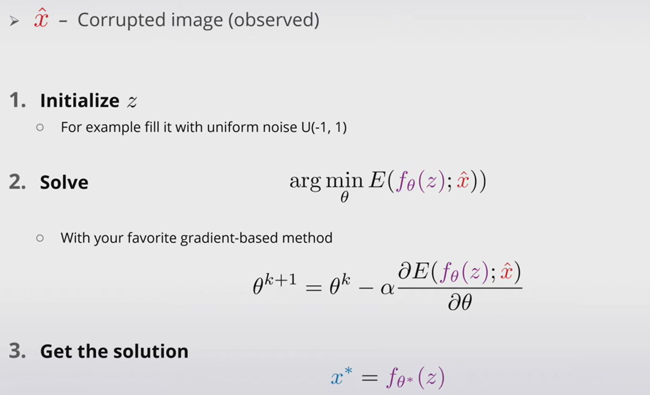
Deep Image Prior Step By Step

Slide 9
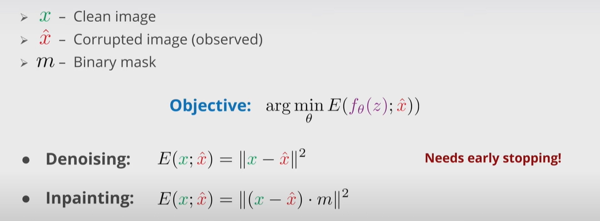
Objective Function

Slide 10
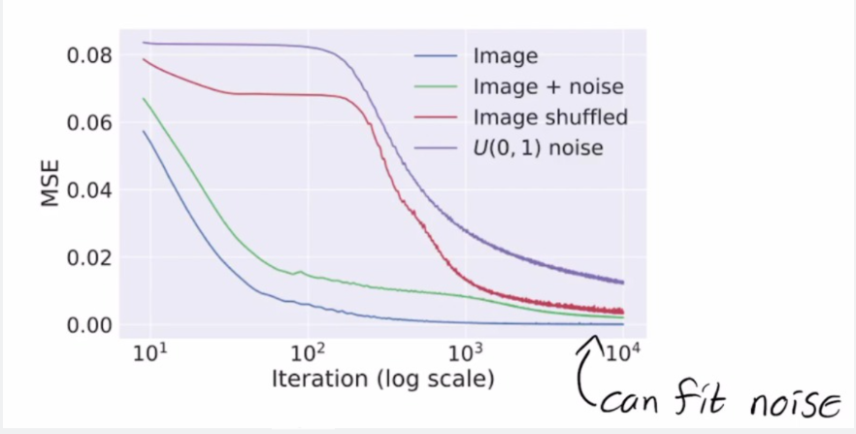
Experiment : Learning Curves for the Reconstruction Task

Slide 11
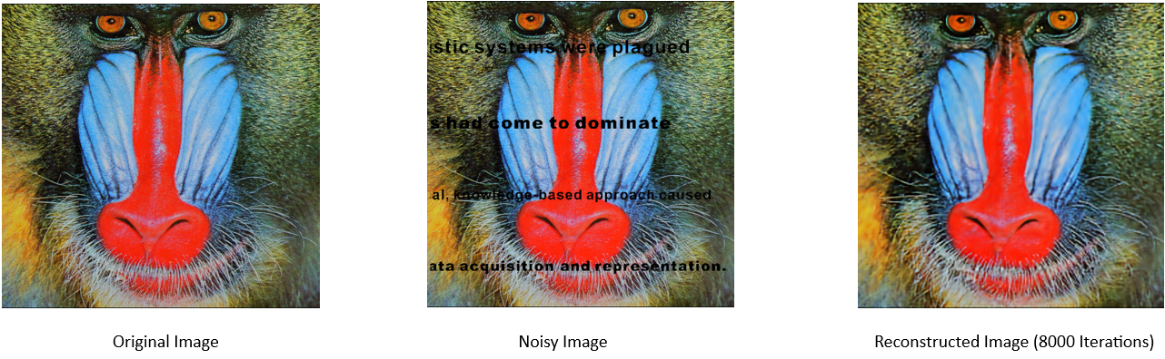
Experiment
Mean Squared Error: 0.008465769766482794 (Between Original Image and Reconstructed Image)

Slide 12
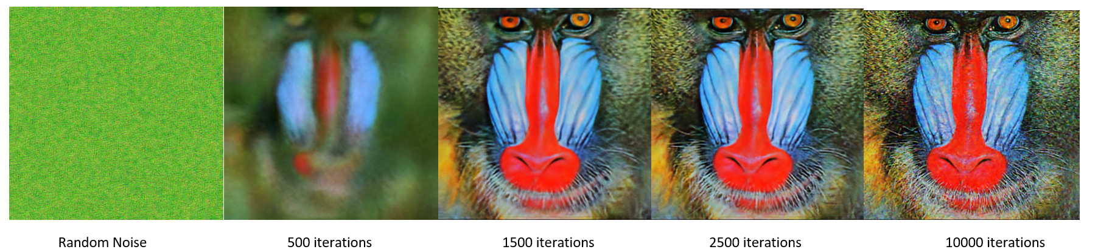
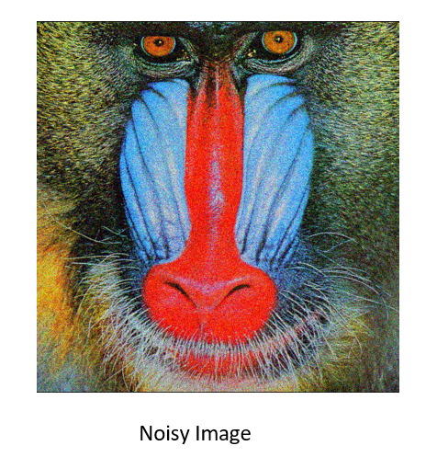
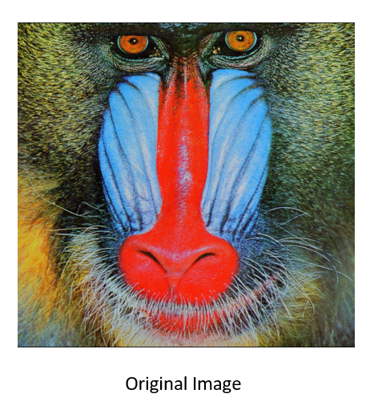
Denoising Results

Slide 13
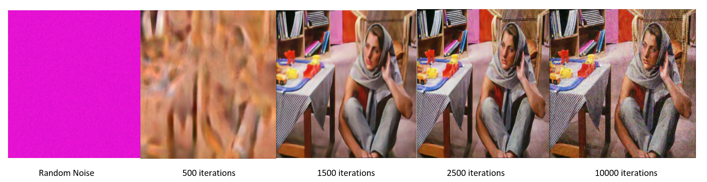
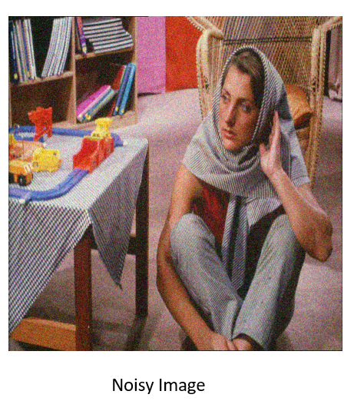
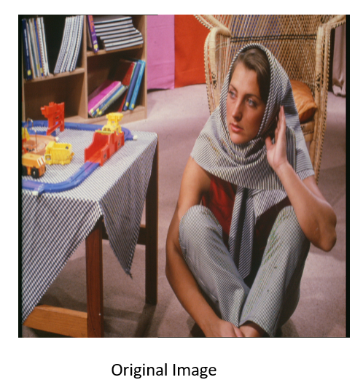
Denoising Results

Slide 14
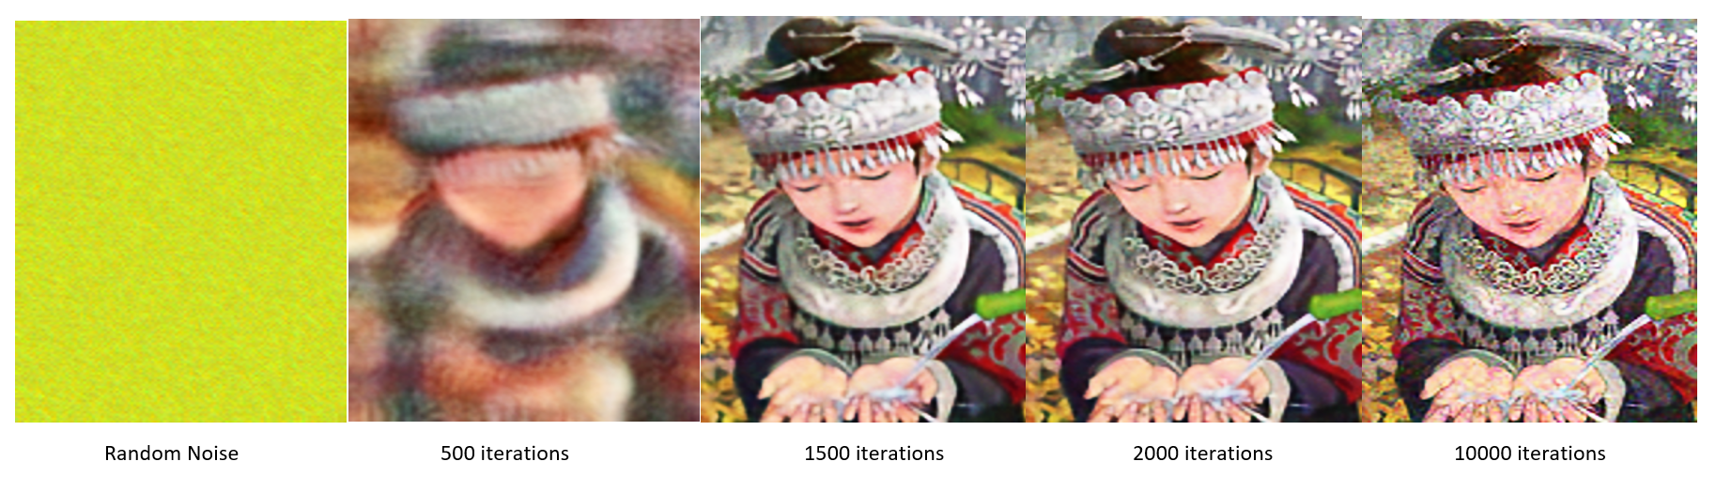
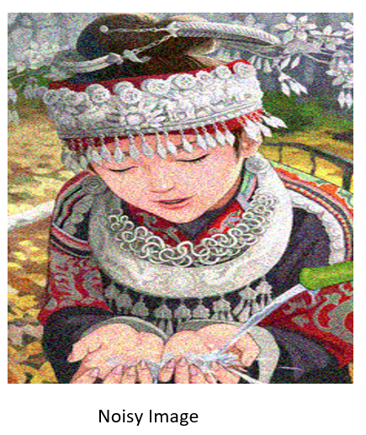
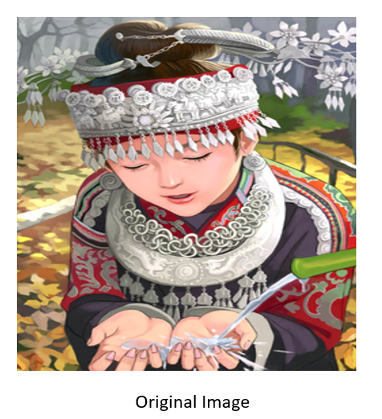
Denoising Results

Slide 15
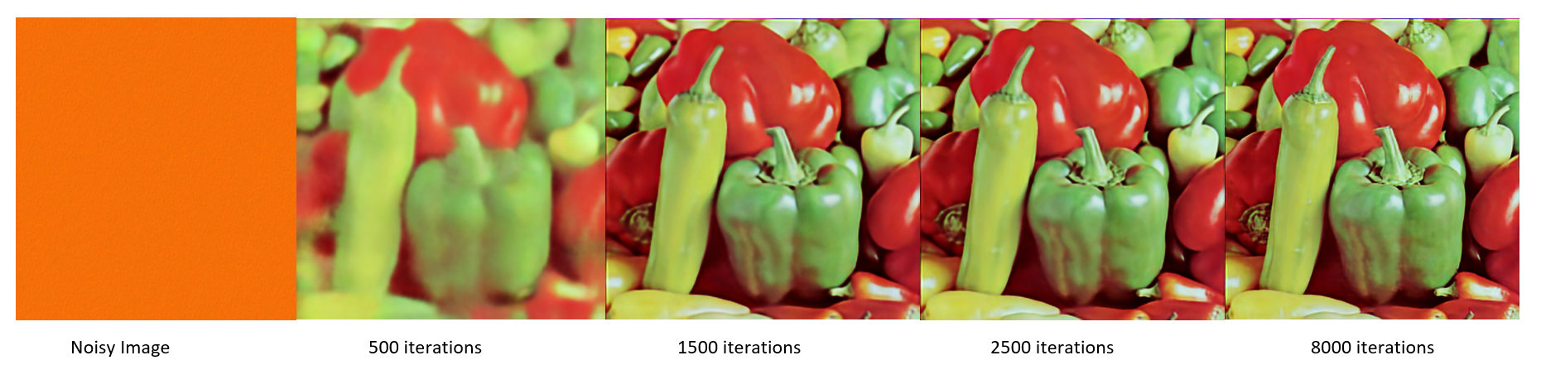
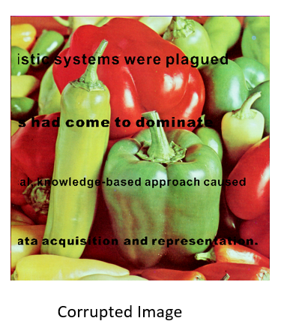
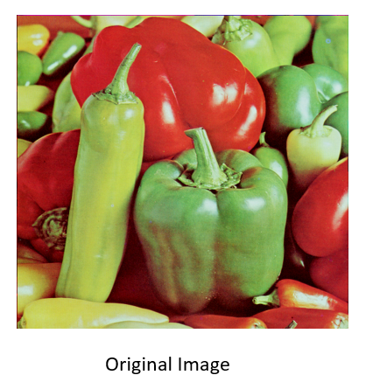
Text Inpainting Results

Slide 16
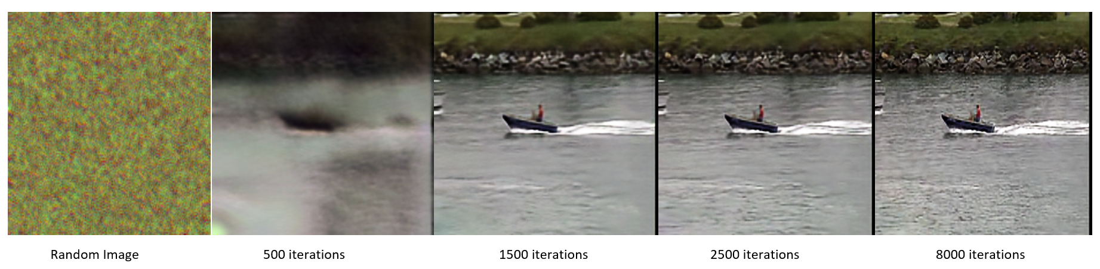
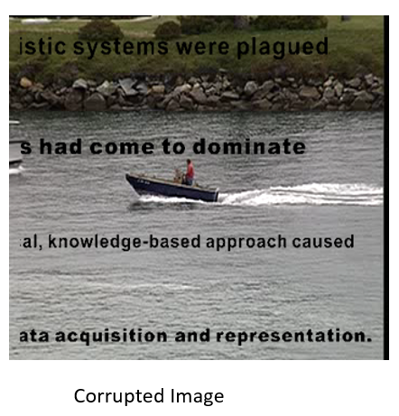
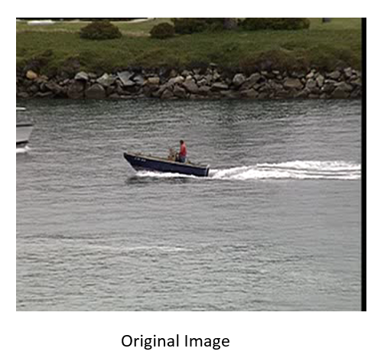
Text Inpainting Results

Slide 17
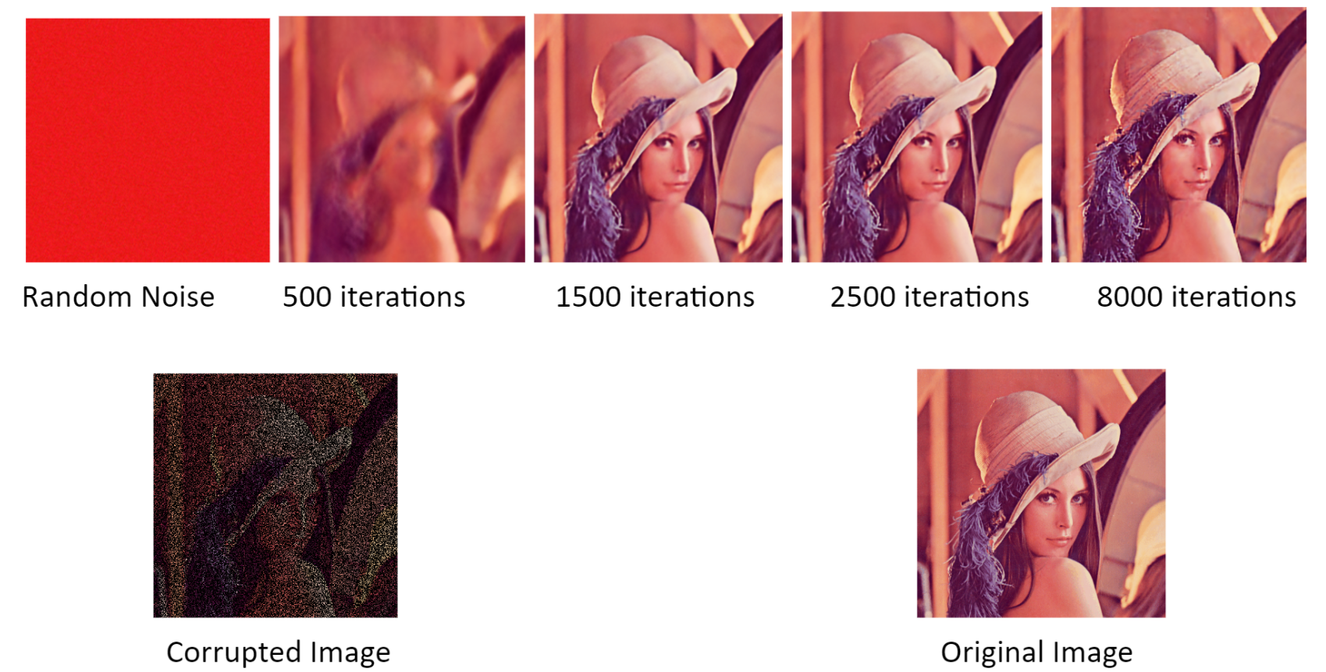
Randomly Damaged Pixels Inpainting Results

Slide 18
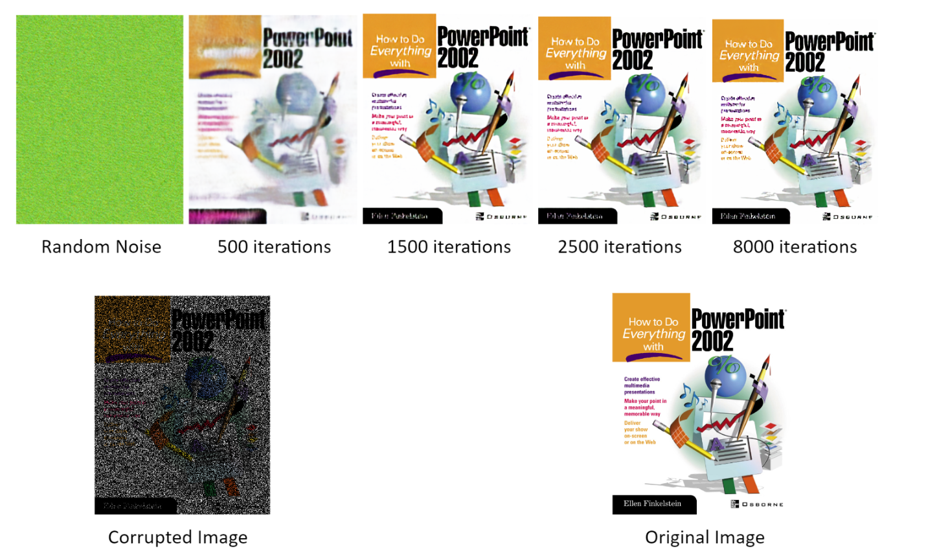
Randomly Damaged Pixels Inpainting Results

Slide 19
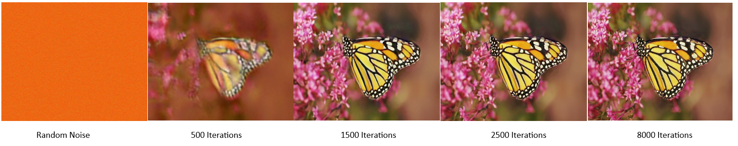
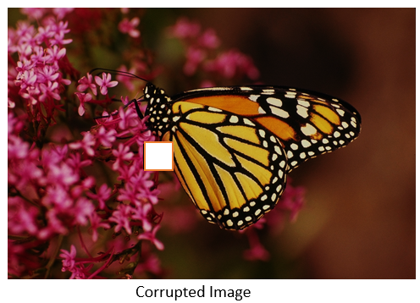
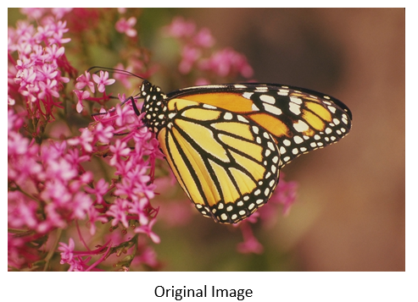
Region Inpainting Results

Slide 20
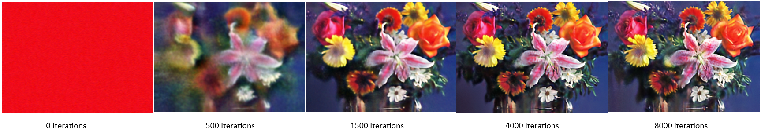
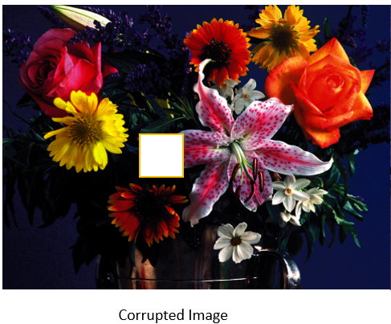
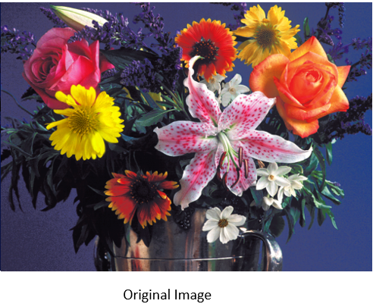
Region Inpainting Results

Slide 21
Contributions
Aman Khandelwal : Prepared the code for Image Conversion (i.e. image pixels change, adding uniform noise, region removal, removing random pixel). Appling Hourglass model for denoising the images and training on noisy images. Showing the restored image and loss for every 500 iterations. Plotting the graph for loss vs epoch. Also evaluated and showing the loss comparison plot for reconstruction task using original Image vs Image+Noise.
Nikhil Khemchandani : Made Standard Hourglass Model with upsampling , downsampling and skip layers using tensorflow-keras and used Adam optimizer for optimizing weights with subject to MSE Loss function . Trained Region Inpainting on masked Images indicating the Missing Regions and showed model accurately restored regional pixels,demonstrating the potential of this approach for image restoration tasks.
Piyush Singh : Text Inpainting and Randomly Damaged Pixels Inpainting. Both were trained with corresponding masks indicating the missing or damaged areas. Results shows that the model accurately restored missing text and damaged pixels, demonstrating the potential of this approach for image restoration tasks.

Slide 22
Results and Code Link
Implementation Link: https://drive.google.com/drive/folders/14EWBmGDl0wENGPBc9TouN8tNK-K-CEAz?usp=sharing
Result Link: https://drive.google.com/drive/folders/15IuyqH3MXX3cSMynFcA4rlhAF9T8YFEB?usp=sharing

Slide 23

THANK YOU

